Slide 1
Machine Learning Made Easy with Azure Custom Vision
Alejandro Ruiz
Microsoft/Xamarin MVP
alejandro@alejandroruizvarela.com

Slide 2
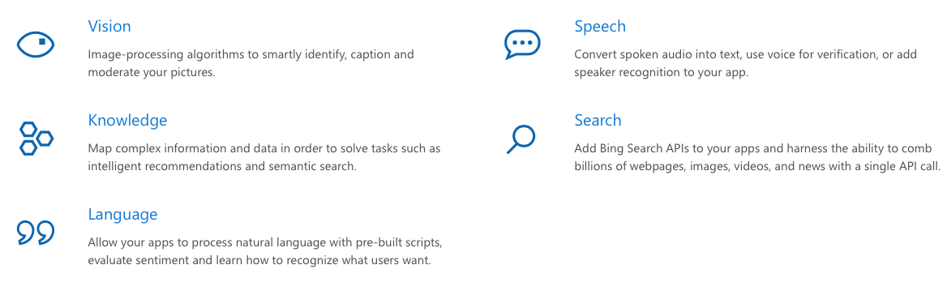
Azure Cognitive Services
Use AI to solve business problems

Slide 3
Vision
Computer Vision
Distill actionable information from images
Face
Detect, identify, analyze, organize, and tag faces in photos
Content Moderator
Automated image, text, and video moderation
Video Indexer - Preview
Unlock video insights
Custom Vision - Preview
Easily customize your own state-of-the-art computer vision models for your unique use case

Slide 4
Custom Vision - Preview
Easily customize your own state-of-the-art computer vision models for your unique use case. Just upload a few labeled images and let Custom Vision Service do the hard work. With just one click, you can export trained models to be run on device or as Docker containers.

Slide 5
The Process

Slide 6
Step 1
Upload Images
Upload your own labeled images, or use Custom Vision Service to quickly tag any unlabeled images.

Slide 7
Step 2
Train
Use your labeled images to teach Custom Vision Service the concepts you want it to learn.

Slide 8
Step 3
Evaluate
Use simple REST API calls to quickly tag images with your new custom computer vision model, or simply export the model to device to run real-time image understanding.

Slide 9
Step 4
Active learning
Images evaluated through your custom vision model become part of a feedback loop you can use to keep improving your classifier.

Slide 10
Mobile Support
iOS
CoreML: With Core ML, you can integrate trained machine learning models into your app.

Slide 11
Mobile Support
Android
TensorFlow™: is an open source software library for high performance numerical computation.

Slide 12
Baby steps with Azure Custom Vision
https://customvision.ai

Slide 13

Lets see Azure Custom Vision in action with Xamarin.Forms
https://github.com/AlejandroRuiz/XamarinFormsAzureCustomVision

Slide 14
Questions?
Alejandro Ruiz
Microsoft / Xamarin MVP
Machine Learning Made Easy with Azure Custom Vision
Demo Code: https://github.com/AlejandroRuiz/XamarinFormsAzureCustomVision
alejandro@alejandroruizvarela.com
http://alejandroruizvarela.blogspot.com
https://github.com/alejandroruiz
@alejandroruizva

